Slide 1
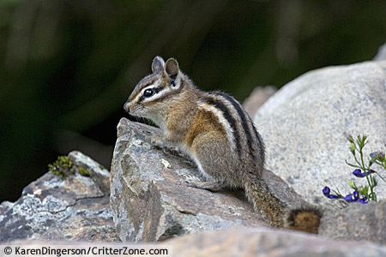
Assessment of gene flow across a hybrid zone in red-tailed chipmunks (Tamias ruficaudus)
Sara Hird and Jack Sullivan
Melissa N. Moyer
Evolution
November 29, 2012
Tamias ruficaudus
Notes:
http://www.planet-mammiferes.org/Photos/Rongeur/Sciuromo/Sciuride/TamiRuf6.jpg
Title

Slide 2
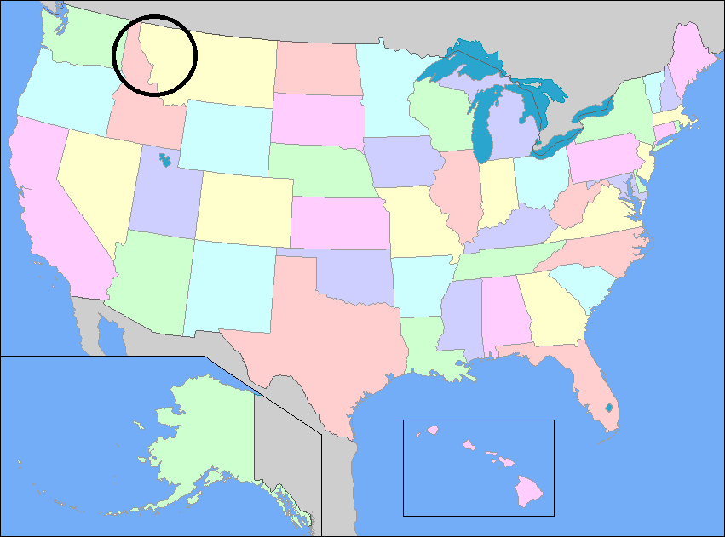
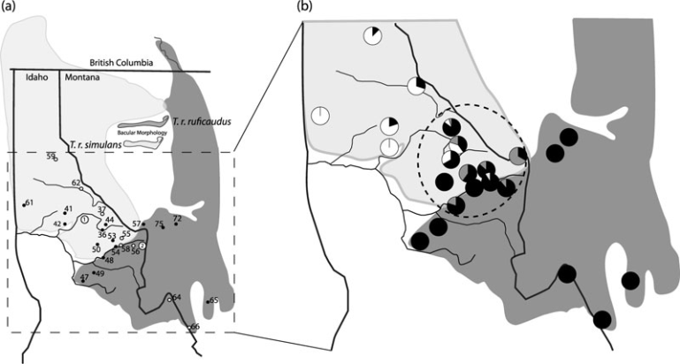
Hybridization
Previously, Hybridization has been considered rare in animals, and thought to try to prevent divergence.
Tamias ruficaudus ruficaudus (eastern) and Tamias ruficaudus simulans (western) overlap across Idaho and Montana
Notes:
Figure 1
http://www.yourchildlearns.com/images/map-of-united-states.gif
Background 1

Slide 3

Subspecies
Subspecies are defined by their
Bacular morphology (penis shape and size), thought to be a mechanical reproductive barrier
Microsatellites – genomic DNA
Mitochondrial DNA (mtDNA)
Bacular Morphology was measured to define the species, although it restricted the sampling to individuals prior to 2003
Notes:
Cut of Figure 1
Background 2

Slide 4
A Gap in the Morphological Barrier Theory
Interspecific mitochondrial introgression has been observed between non sister species, suggesting bacular morphology may not impose barrier
T. ruficaudus and Tamias amoenus
Notes:
Background 3

Slide 5
Hypotheses
Assess patterns of genetic variation across the Loscha River (southern boundary) at neutral, nuclear loci
Explain role of hybridization and incomplete lineage sorting in the system
Assess the relative timing and amount of gene flow between subspecies to place hybridization events in context
Notes:
Concept 1

Slide 6
Sampling
191 chipmunks sampled 1999 – 2007
Genomic DNA extracted from
Ear clips
Livers
Kidneys
Both mtDNA and gDNA were amplified using PCR
Notes:
Concept 2

Slide 7
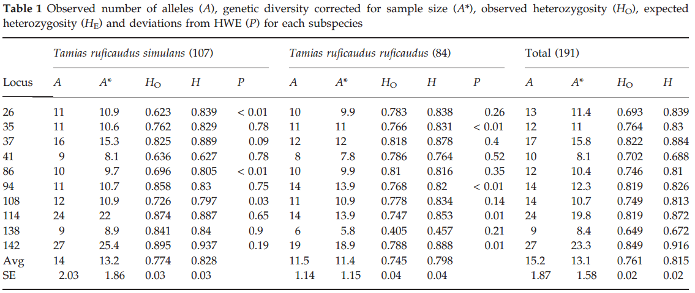
Microsatellite diversity
Heterozygosity
Observed: .405 - .895
Expected: .457 -.937
4 of 140 tests deviated from Hardy Weinberg Equilibrium.
Within a subspecies – 7 of 20 tests were significant
Notes:
Concept 3

Slide 8
Analysis Hypothesis 1 Patterns of Genetic Variation Across the Loscha River
BayesAss determined that 188 out of 191 individuals had been assigned to appropriate subspecies defined by bacular morphology - gDNA
GeneClass2 assigned 98% of the individuals to their correct sub species - mtDNA
NewHybrids - mtDNA
74/84 T. r. ruficaudus assigned to pure parental
4/84 T. r. ruficaudus assigned to F2
6/84 T. r. ruficaudus not assigned
42/107 T. r. simulans assigned to F2
5/107 T. r. simulans assigned to backcross
60/107 T. r. simulans not assigned
Notes:
Concept 4

Slide 9
Analysis Hypothesis 2 Role of Hybridization and Incomplete Lineage Sorting
Evidence to reject incomplete lineage sorting in favor of hybridization.
mtDNA is radiating outward from the hybrid zone rather than randomly as incomplete lineage sorting suggests
Migration rates are non-zero, implying gene flow
Hybrid zone is stable, although current hybridization is occurring at low levels
Notes:
Concept 5

Slide 10
Analysis Hypothesis 3 Placing Hybridization Events in Context
Divergence estimated around 325,000 years ago
90% credibility interval dates range from 186,000 to over 2 million years ago
Hybridization events may have been relatively frequent throughout time and occurred since divergence
Notes:
Concept 6

Slide 11
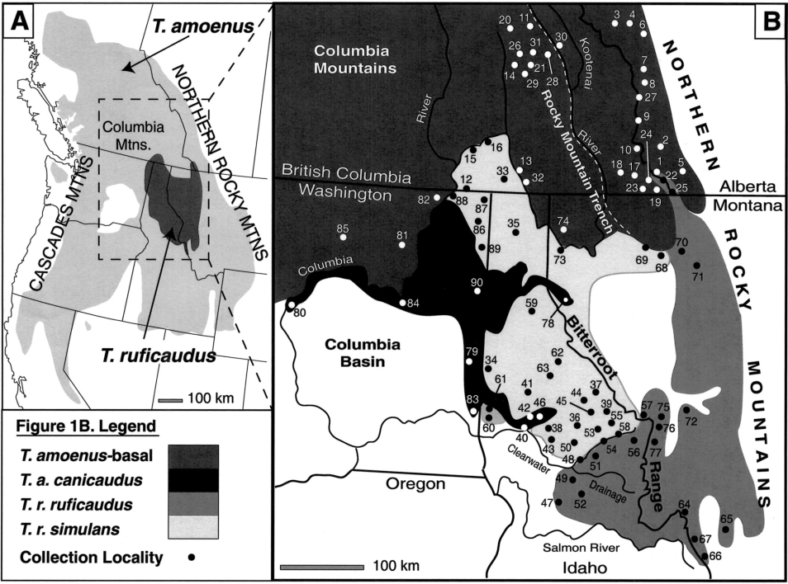
Phylogeography and Introgressive Hybridization: Chipmunks (Genus Tamias) in the Northern Rocky Mountains
Hybridization among chipmunks is occurring despite bacular differences despite what was previously thought.
Ruled out ancestral mtDNA as the cause of mtDNA mixing between species because the cross radiates outward from Hybridization areas for all four chipmunk species
Notes:
Other paper 1

Slide 12
Phylogeography and Introgressive Hybridization: Chipmunks (Genus Tamias) in the Northern Rocky Mountains
Data suggests mtDNA introgression is a poor indicator of nuclear gene flow
mtDNA introgression must have been generated by reproduction between T. r. ruficaudus females and T. r. simulans or T. amoenus males as there has been no evidence of it in reverse
Notes:
Other paper 2

Slide 13
Ancient Hybridization and Mitochondrial Capture Between Two Species of Chipmunks
The history between Tamias amoenus and Tamias ruficaudus has been complex and many possible hybridization events have occurred.
Hybridization among chipmunks is occurring despite bacular differences despite what was previously thought.
There are at least two instances where mtDNA has been exchanged across species

Slide 14
Conclusions
Despite differences in bacular morphotype, chipmunk species are hybridizing at low rates
mtDNA differentiation at this boundary is strong but not complete
Hybridization is the source of integration with non-zero estimates of migration and gene flow in a variety of methods
Notes:
Conclusion 1

Slide 15
Conclusions
The mtDNA vs. the gDNA is still controversial, but hybridization is still preferred over incomplete lineage sorting
It’s still not clear if T. r. simulans and T. r. ruficaudus should each be their own species.
Notes:
Conclusion 2

Slide 16
Literature Sited
Good JM, Demboski JR, Nagorsen DW, Sulivan J. 2003. Phylogeography and introgressive hybridization: Chipmunks (genus Tamias) in the northern rocky mountains. Evolution. 57(8):1900–1916
Good JM, Hird S, Reid N, Demboski JR, Steppan SJ, Martin-Nims TR, Sulivan J. 2008. Blackwell Publishing Ltd Ancient hybridization and mitochondrial capture between two species of chipmunks. Mol Ecol. 17:1313–1327
Hird S, Sullivan J. 2009. Assesment of gene flow across a hybrid zone in red-tailed chipmunks (Tamias ruficaudus). Mol Ecol. 18:3097-30109.
http://www.planet-mammiferes.org/Photos/Rongeur/Sciuromo/Sciuride/TamiRuf6.jpg
http://www.yourchildlearns.com/images/map-of-united-states.gif
Notes:
Lit. Sited.

